Slide 1
Need Hope?
October 2
6 PM
Jolly Park
COMMUNITY CELEBRATION
Rain Venue:
Limestone, Fullerton Auditorium

Slide 2
Need Hope?
October 2
6 PM
Jolly Park
COMMUNITY CELEBRATION
Rain Venue:
Limestone, Fullerton Auditorium
/LYC-Upstate

Slide 3
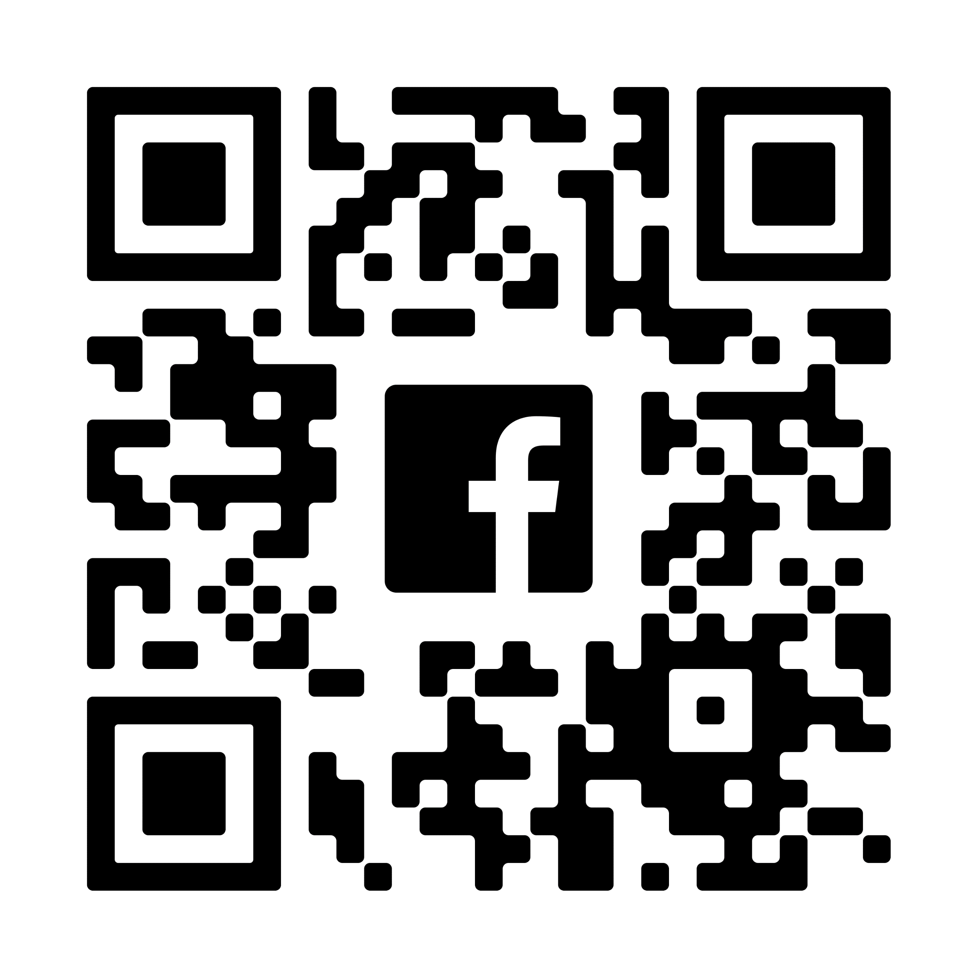
Need Hope?
October 2
6 PM
Jolly Park
COMMUNITY CELEBRATION
Rain Venue:
Limestone, Fullerton Auditorium

