Slide 2
Pray and Go Vision
Acts 1:8 You will receive power and you will by My witnesses.
The address of your church is not an accident.
God has the exact people in your church to reach the exact people in your surrounding community.
It is a mandate that will begin to transform your church and your local community.

Slide 3
Pray & Go Strategy
Step #1
Step #2
Step #3
Step #4
Step #5
Step #6
Determine your community
Map out your community
Appoint an Administrator/ Leadership Team
Create an email address/ Design door hangar
Build your pray and go teams and their schedule
Pray and Go
Decide what size your community will be. How many homes.
Use Missioninsite or Bless every home to plot/chart the homes you will pray for
Keeps track of the progress as well as what community needs you discover.
For community members to email physical/ spiritual needs. Door hangar lets them know they have been prayed for
Teams alternate on a once every 2 months schedule to keep everyone engaged and eager to serve.
Implement and watch God through the power and simplicity of prayer transform your congregation and community
Part 1
Part 2
Part 3
1500 homes ÷ 52 weeks is 28 homes per week. 2 prayer teams will cover 14 homes per week.
Administrator must have organization skills to track progress throughout the year and diligently check emails for community needs.
This ministry is high impact low commitment. 48 people in pairs would be required to pray and go once every 2 months to cover 1500 homes.

Slide 4
There are endless designs for your door hanger however, it must be simple. Church statistics show that people respond better to concise information. The front says we prayed for you. The back has church name, phone number and email address where someone can help them if they are in need of anything. This simple door hanger along with the power of prayer will change how the community sees your church. It shows that you love them without expecting anything in return.
Give us a call at 864-489-3119 or email us at brbaprayer@gmail.com if you have anything that you need

Slide 5
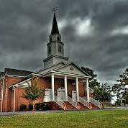
This simple door hanger along with the power of prayer will change how the community sees your church. It shows that you love them without expecting anything in return.
@
Hopewell Baptist Church
Let us know how we can pray for you.
(864)839-6643
hopewellcares@gmail.com

Slide 6
Pray & Go Process
Meet at your church and pray before you go. Before the apostles went, they prayed and waited on the power of the Holy Spirit.
1
2
Pray sincerely at each address and then leave a pray and go door hanger on the front door and trust God to move in that family's life.
3
As you go, look for divine appointments with community members who are outside as you Pray & Go.
4
Return to the church and record where you have been and what God has done.

Slide 7
Pray & Go
Keys to
Success
Pray & Go is year-round. It’s in the DNA of your church.
The Pastor must be a visionary cheerleader. Not the one doing all the work
Cast a vision with high commitment and high expectations but not a heavy burden
Not just another strategy for a new ministry but it is a strategy to create a biblical culture of going.
Highest commitments are from the coordinator, map strategist, and prayer request email response team
A successful pray and go ministry keeps detailed records
This is a consistent, biblical, great commission ministry for your church
Mention Pray & Go on a consistent weekly basis. Highlight what God has done through this ministry
Pray & Go is not a magic bullet for church issues but will bring transformation.

Slide 8
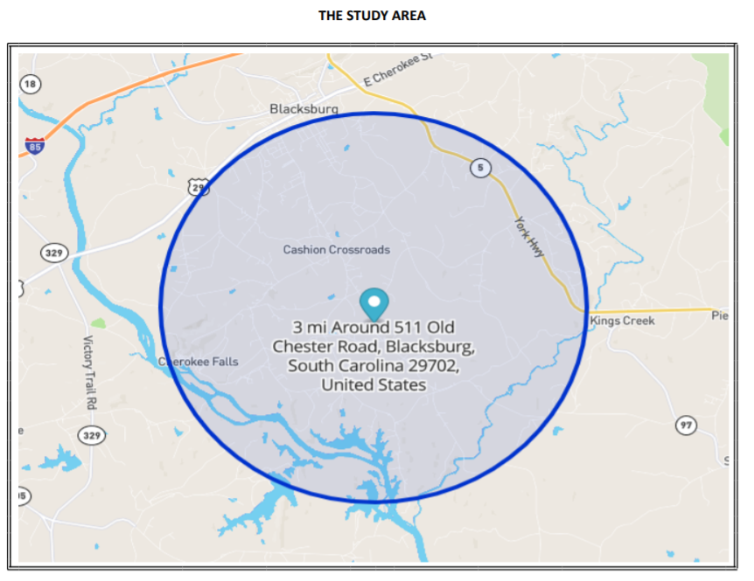
3 Mile Radius From Hopewell
2021 Population: ≈3,500
People not involved in church:
≈2,200
(63%)

Slide 9
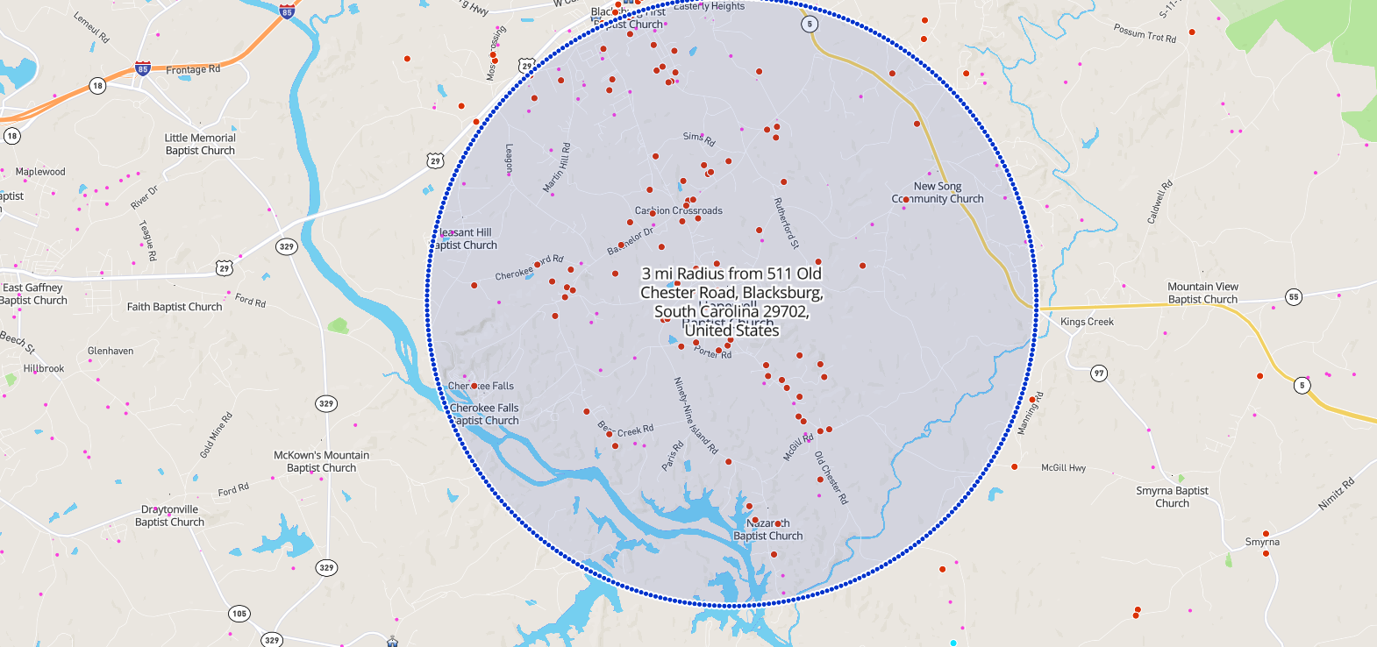
1,362 Households
703 children ages 0-17
34 Single Moms
92 Separated
328 Divorced
314 Widows
159 below Poverty
550 adults with no HS Diploma

Slide 10
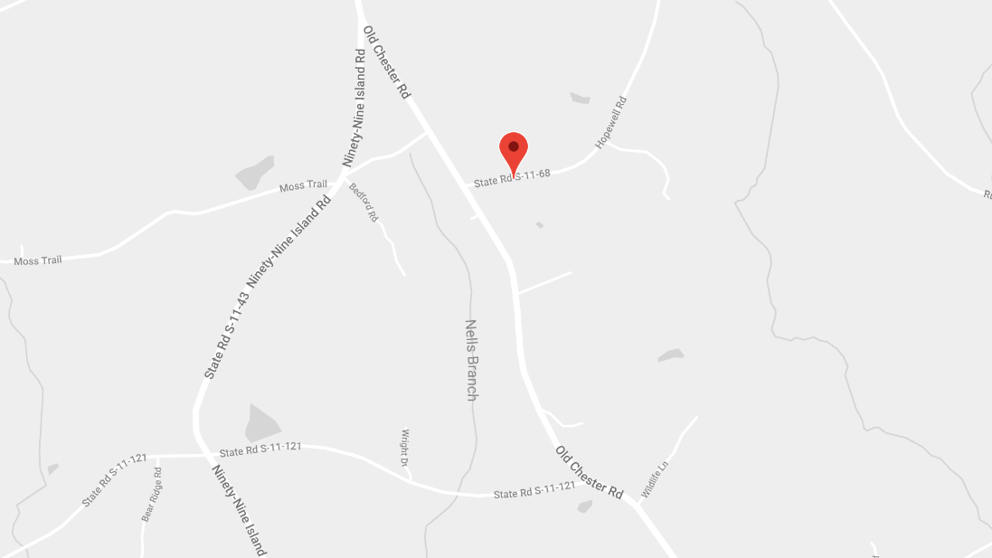
*Print out a Map of the streets near your church, and place a star or pin on the streets you have covered.

Slide 11
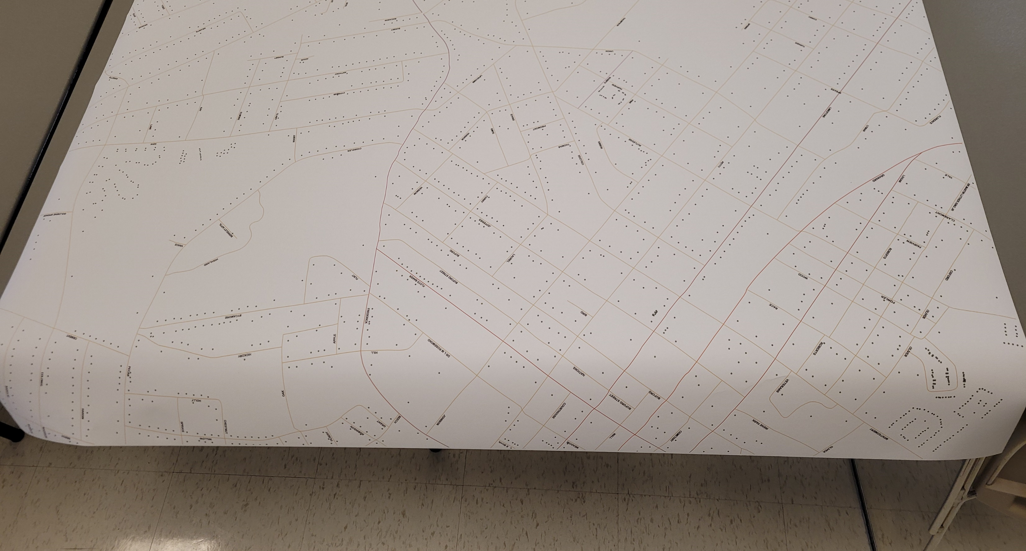
Map Printed by the County

Slide 12
GOOGLE MAPS

Slide 13
Download the Encounter Outreach App to take notes and track progress.

